Slide 1

Disease Dataset
Jinming Chen
Alejandra Zapata
Structure Data Management
Prof. Samuel Strum Fall 2020

Slide 2
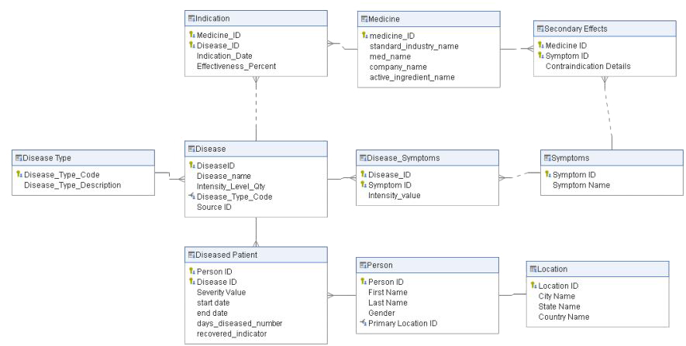

Introduction and
Business Value
01
Fig 1. ERD Diagram
EXPECTED OUTCOMES:
Analyze common diseases amongst patients under 10 y/o. in american and chinese cities.
Measure effectiveness indicators and intensity of diseases.
Understand symptoms, and timelined per patient.

Slide 3
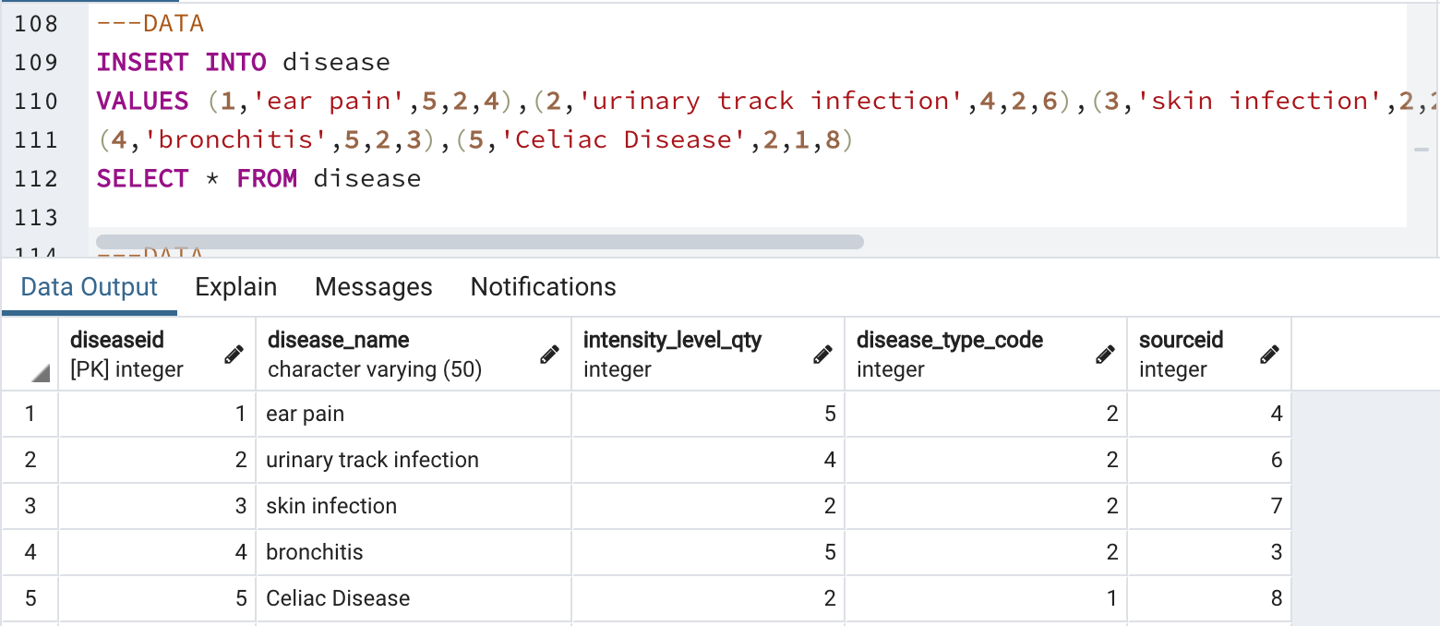
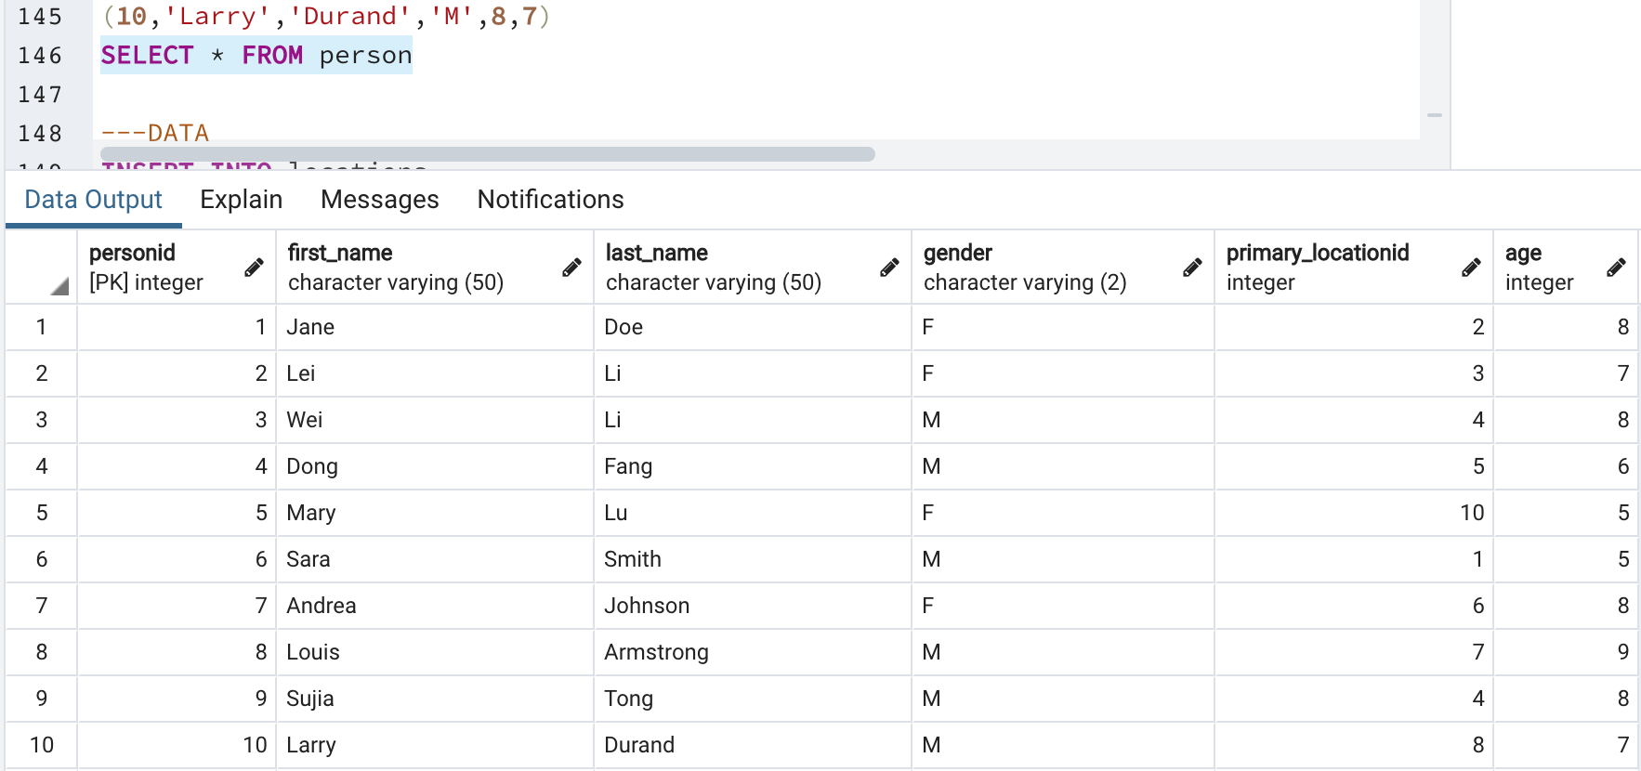
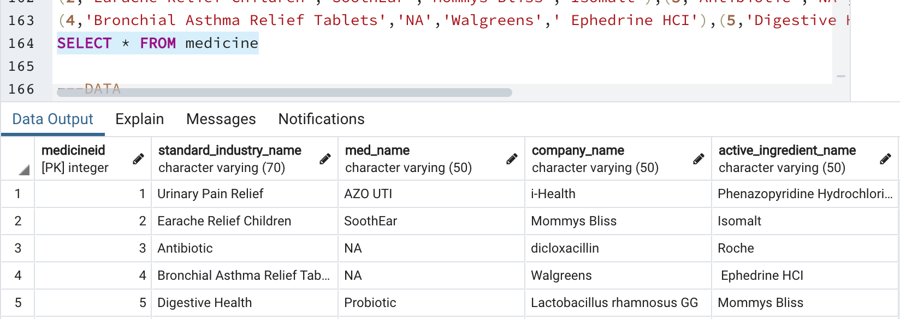
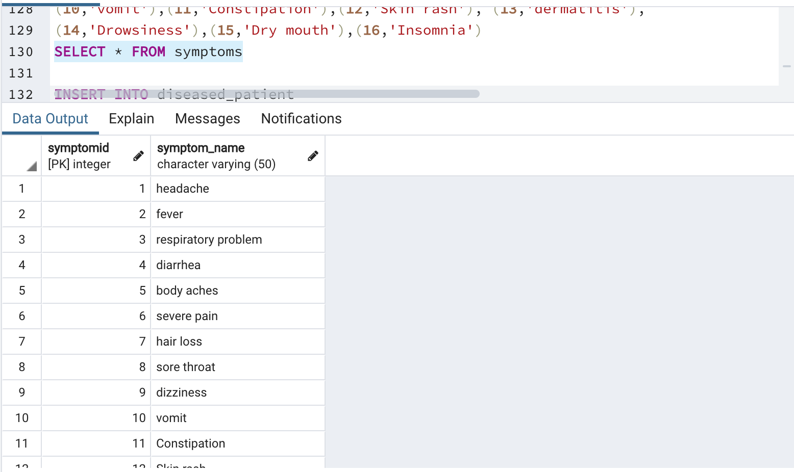
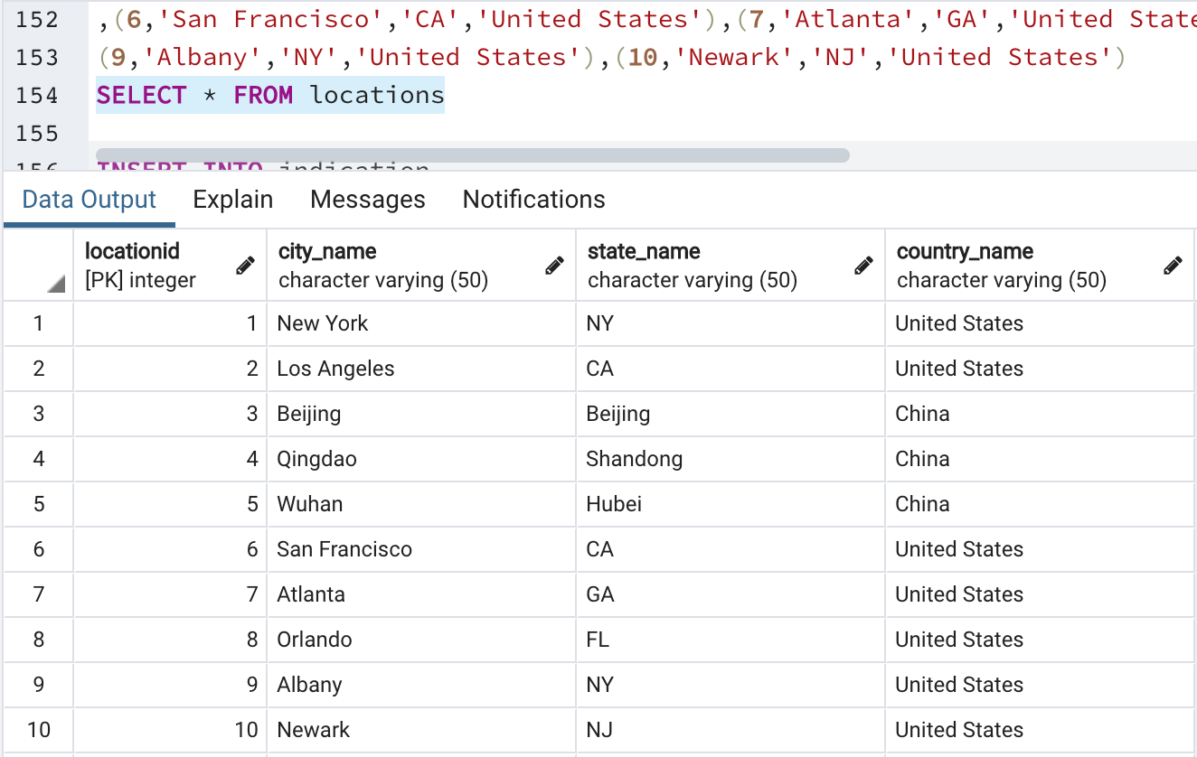
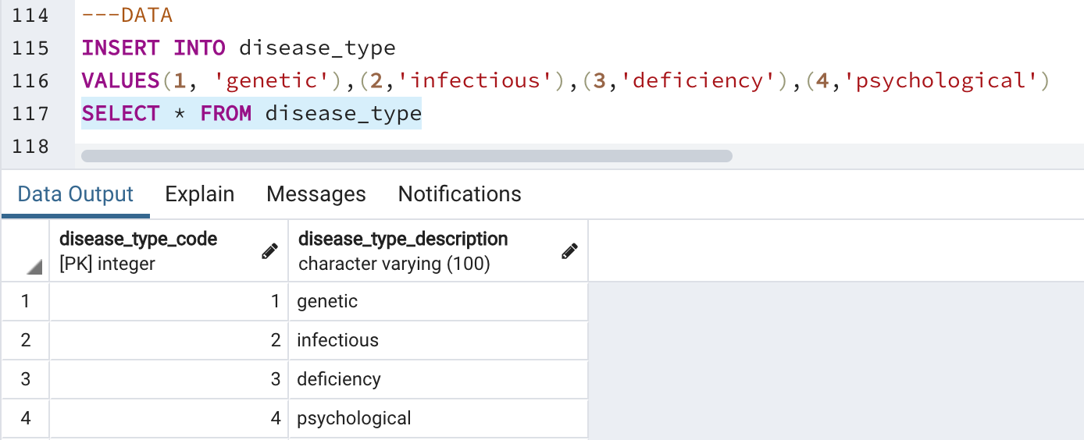
Dataset & DDL
02
Fig 1. Disease Table
Fig 4. Person Table
Fig 2. Medicine
EXPECTED OUTCOMES:
Analyze common diseases amongst patients under 10 y/o.
Measure effectiveness indicators and intensity of diseases.
Understand symptoms, and timelined per patient.
Fig 3. Disease Type
Fig 5. Symptom Table
Fig 6. LocationTable

Slide 4
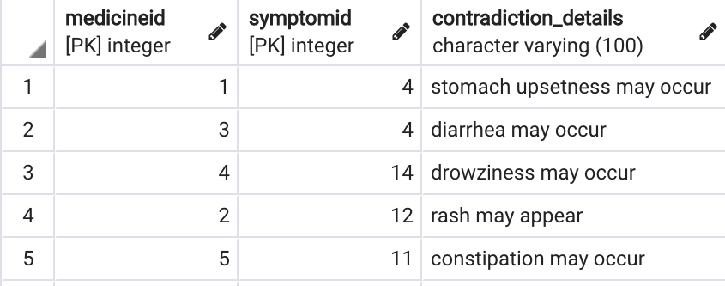
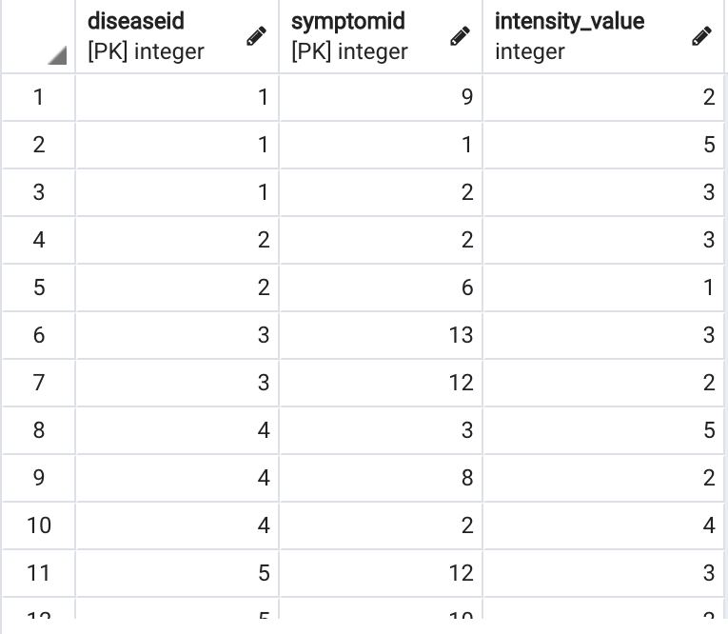
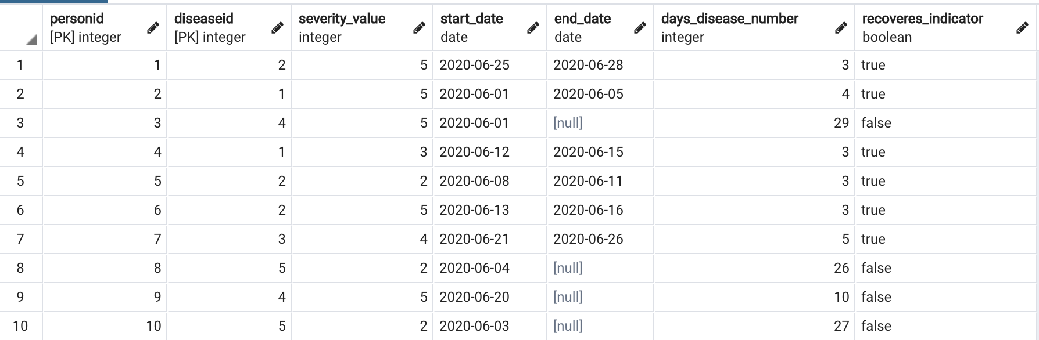
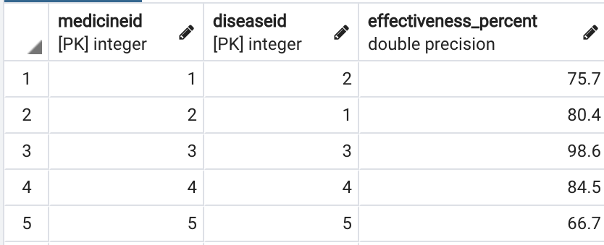
Dataset & DDL: Bridge Tables
02
The bridges table below start to hint to the relationships between disease/ person, disease/symptom, disease/medicine amongst others, which solve our many to many relationships.
Fig 7. Secondary Effects Table
Fig 9. Disease_Symptom Table
Fig 10. Disease_Person Table
Fig 8. Indication Table

Slide 5
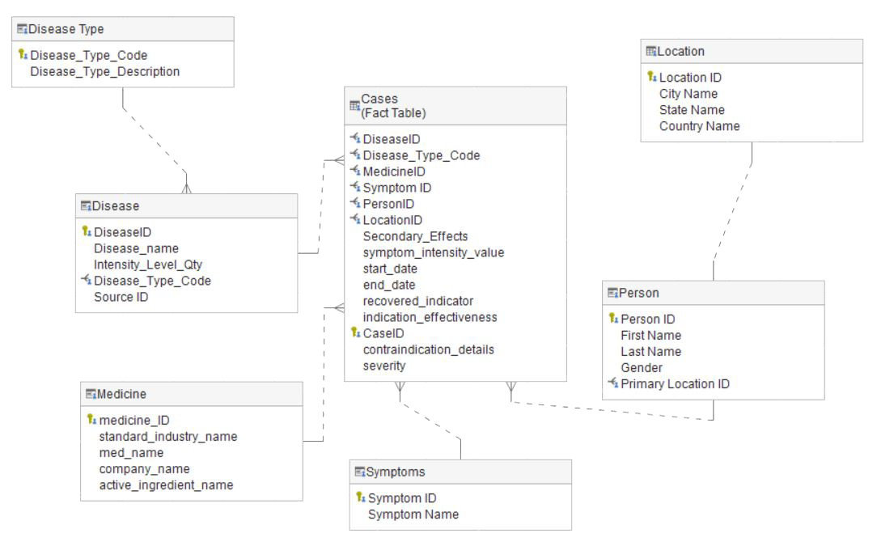
Dimensional Model & ELT Process
03
CREATE TABLE disease_dw.cases_dis_fact
(caseID SERIAL PRIMARY KEY,
start_date date, end_date date,
recovered_indicator boolean,
symptoms_intensity_value int,
indication_effectiveness int, severity int,
diseaseID int references disease_dw.disease (diseaseID),
disease_type_code int references disease_dw.disease_type (disease_type_code ),
medicineID int references disease_dw.medicine (medicineID),
symptomID int references disease_dw.symptoms (symptomID),
personID int references disease_dw.person (personID),
locationID int references disease_dw.locations (locationID)
ON delete CASCADE);
Assign PK to fact table
Assign references to all the dimensions
Fig 11. Snowflake schema
The dimensional model gave us the opportunity to have a more condensed model.
We used the OLTP and server side code to load the data
Our dimension model is a snowflake schema.
Referential integrity
Sample Code to create fact table

Slide 6
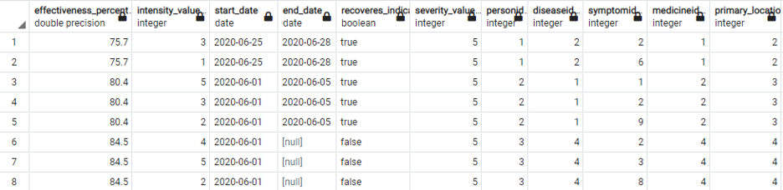
Server Side Code to transfer data
03
INSERT INTO disease_dw.cases_dis_fact (start_date,end_date, recovered_indicator, symptoms_intensity_value,indication_effectiveness, severity, diseaseID , disease_type_code, medicineID,symptomID, personID, locationID)
(SELECT DISTINCT f.start_date,f.end_date, f.recoveres_indicator,f.intensity_value,f.effectiveness_percent, f.severity_value,
a.diseaseID, d.disease_type_code,c.medicineID, b.symptomID, e.personID, e.primary_locationID
FROM disease_dw.disease a, disease_dw.symptoms b, disease_dw.person e, disease_dw.medicine c,disease_dw.disease_type d,public.cases_info4 f
WHERE a.diseaseID=f.diseaseID
AND b.symptomID=f.symptomID
AND c.medicineID=f.medicineID
AND d.disease_type_code=f.disease_type_code
AND e.personID=f.personID
AND e.primary_locationID=f.primary_locationID);
CREATE OR REPLACE VIEW cases_info4 AS
SELECT x.effectiveness_percent, n.intensity_value, n.start_date,n.end_date, n.recoveres_indicator,n.severity_value, n.personID, n.diseaseID, n.symptomID, n.medicineID, n.primary_locationID, n.disease_type_code
FROM public.indication x
LEFT JOIN cases_info3 n
ON x.medicineID=n.medicineID
and x.diseaseID=n.diseaseID
INSERT INTO disease_dw.disease
(SELECT * FROM public.disease);
Fig 12. View Result
Type 1. Sample Code to insert data from OLTP
Using the ‘VIEW’ server side code to transfer relevant data from bridges table to fact table in our dimension model.
Type 2.Sample Code to insert data from OLTP

Slide 7
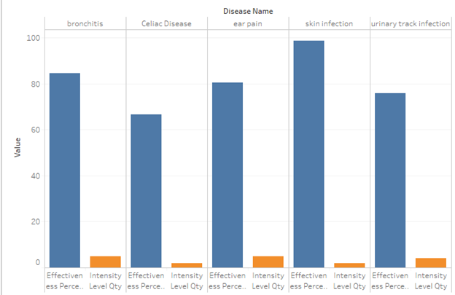
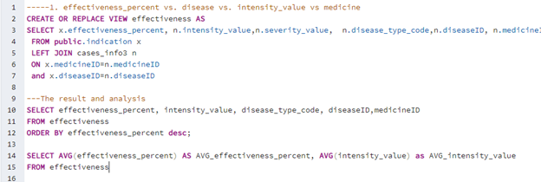
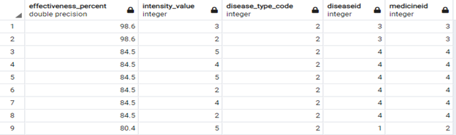
Business Analytics
04
1. Effectiveness_percent vs. disease vs. intensity_value

Slide 8
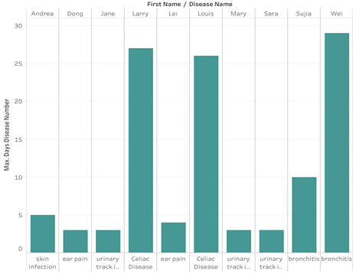
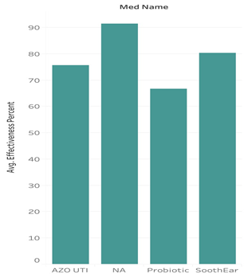
Business Analytics
04
2. Medicine vs. Effev. Percent vs. Day of diseased

Slide 9
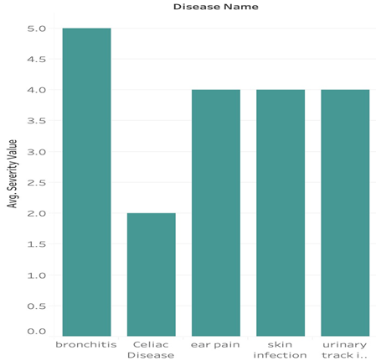
Business Analytics
04
3. Avg. Severity value vs. Disease

Slide 10
SQL vs. NOSQL
05
Document based, graph databases, key-value pairs, or wide-column stores
Relationships
Neo4J
Finding new relationship

Slide 11
Architecture and Process
06
Amazon Relational Database Service
Network address translation gateway
Amazon ElastiCache
Amazon’s Elastic Compute Cloud
Amazon Elastic File System

Slide 12
Thanks for listening!
Questions?

